Slide 1

IRIS FLOWER DATASET CLASSIFICATION
RNS INSTITUTE OF TECHNOLOGY
BENGALURU - 98
DEPARTMENT OF INFORMATION SCIENCE & ENGINEERING
Presentation on Internship
Candidate Name:S.Sumanth
USN: 1RN18IS088
Candidate Name:Saloni Kumari
USN: 1RN18IS090
New Age Solutions Technologies
Internal Guide
Dr. Prakasha S
Associate Professor, Dept of ISE, RNSIT
External Guide
Mr. Deepak Garg
Founder, NASTECH, Bangalore

Slide 2
AGENDA
Abstract
About the Company
Introduction
Literature Survey
Requirements
System Design
Implementation
Result
Conclusion and Future Enhancements
References

Slide 3
ABSTRACT
The Iris flower data set is a multivariate data set introduced by the British statistician and biologist Ronald Fisher in his 1936 paper The use of multiple measurements in taxonomic problems.
It is sometimes called Anderson's Iris data set because Edgar Anderson collected the data to quantify the morphologic variation of Iris flowers of three related species.
The data set consists of 50 samples from each of three species of Iris (Iris Setosa, Iris virginica, and Iris versicolor)
This dataset became a typical test case for many statistical classification techniques in machine learning such as support vector machines

Slide 4
About the Company
NASTECH is formed with the purpose of bridging the gap between Academia and Industry.
NASTECH is one of the leading Global Certification and Training service providers for technical and management programs for educational institutions.
They collaborate with educational institutes to understand their requirements and form a strategy in consultation with all stakeholders to fulfill those by skilling, reskilling and upskilling the students and faculties on new age skills and technologies.

Slide 5
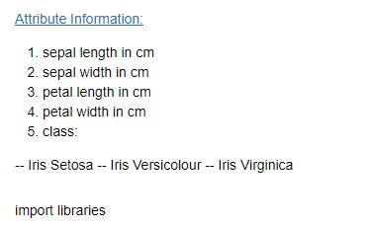
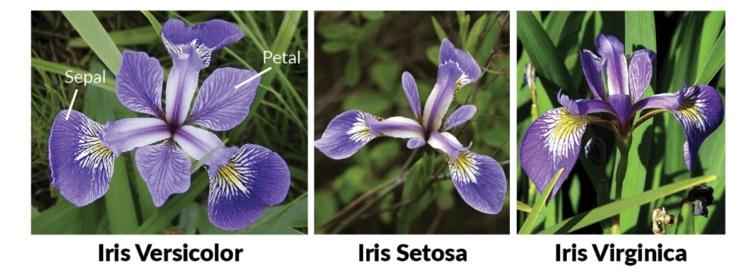
INTRODUCTION

Slide 6
Requirements
Hardware Requirements
- Processor: Pentium IV or above
- RAM: 4 GB or more
- Hard Disk: 2GB or more
Software Requirements
- Operating System: Windows 7 or above
- IDE: Google Colab
Tools/Languages/Platforms
- Python

Slide 7
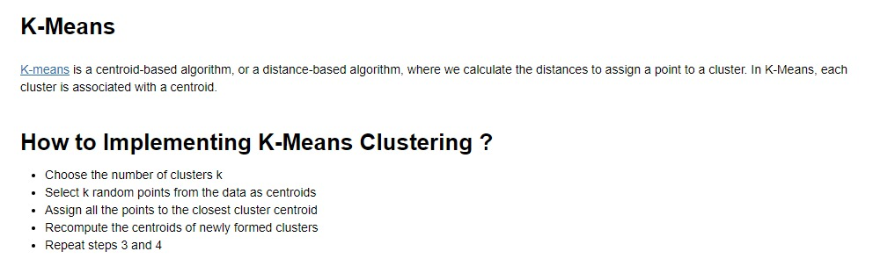
System Design

Slide 8
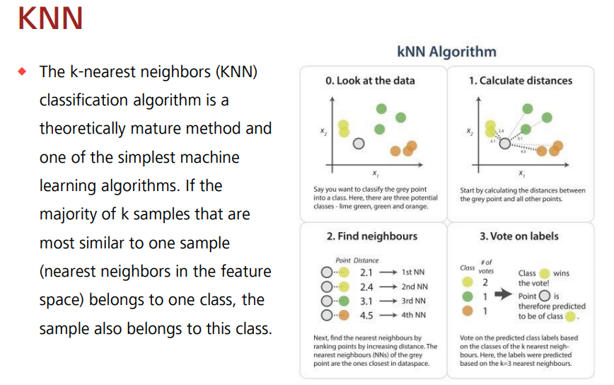
Algorithm

Slide 9
Coding
Evaluation on Test Data
knn = KNeighborsClassifier(n_neighbors=5, p=2, metric='minkowski')
knn.fit(x_train, y_train)
print('The accuracy of the knn classifier is {:.2f} out of 1 on training data'.format(knn.score(x_train, y_train)))
print('The accuracy of the knn classifier is {:.2f} out of 1 on test data'.format(knn.score(x_test, y_test)))
Visualizing Our predictions
k_range = list(range(1,26))
scores = []
for k in k_range:
knn = KNeighborsClassifier(n_neighbors=k)
knn.fit(x, y)
y_pred = knn.predict(x)
scores.append(metrics.accuracy_score(y, y_pred))
plt.plot(k_range, scores)
plt.xlabel('Value of k for KNN')
plt.ylabel('Accuracy Score')
plt.title('Accuracy Scores for Values of k of k-Nearest-Neighbors')
plt.show()

Slide 10
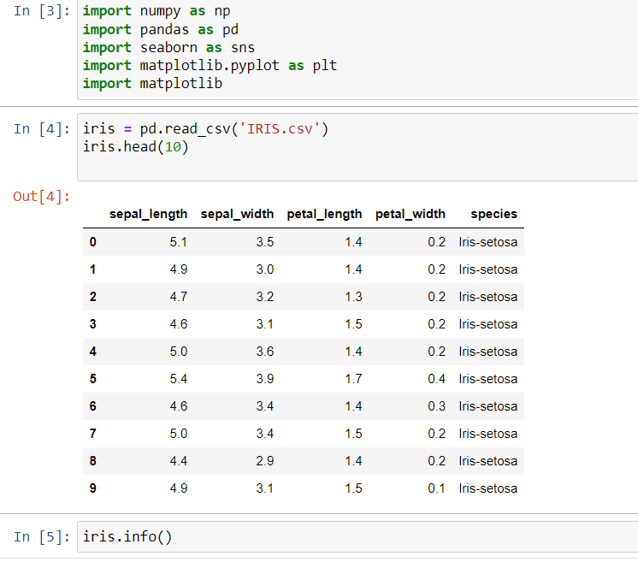
Implementation
Reading CSV File

Slide 11
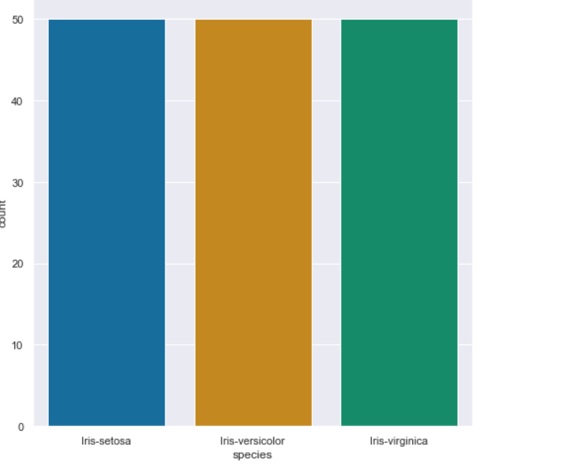
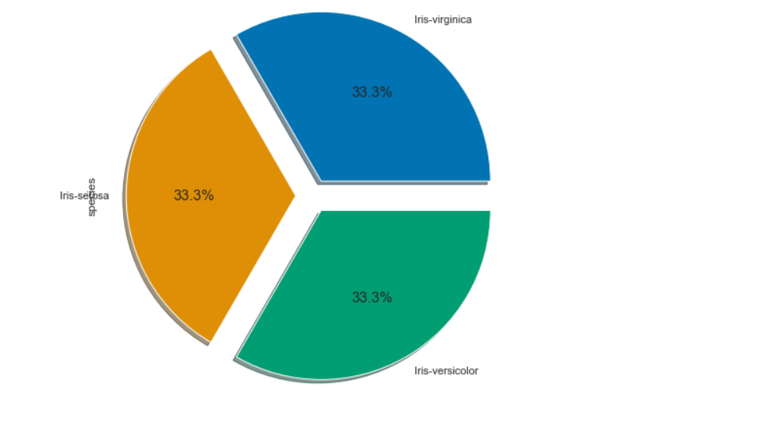
Implementation
Dataset Preparation

Slide 12
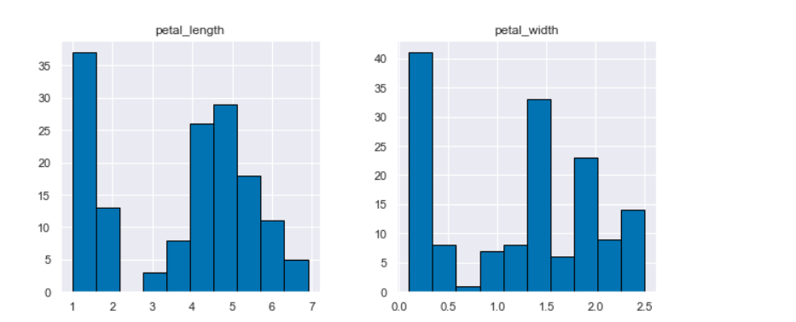
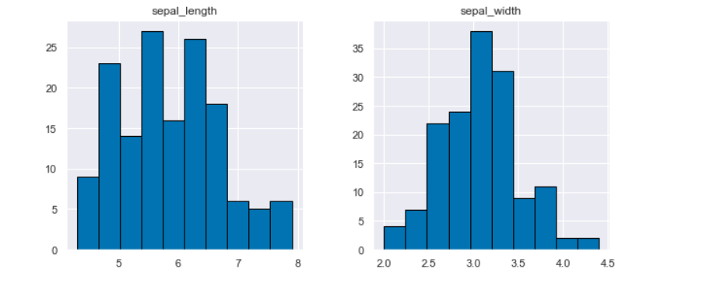
Implementation
Exploratory Data Analysis

Slide 13
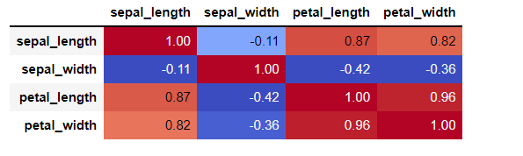
Implementation

Slide 14
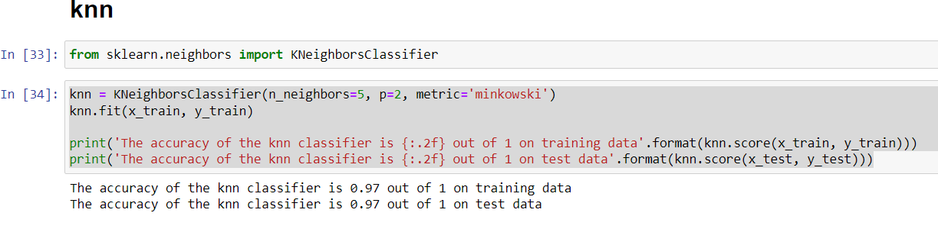
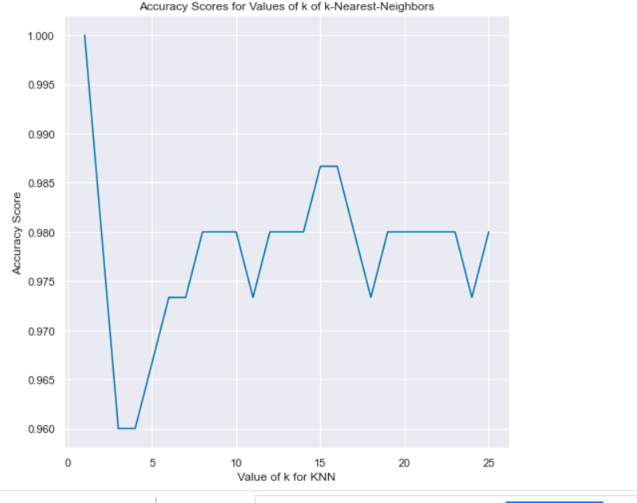
Implementation
KNN regression is a non-parametric method that, in an intuitive manner, approximates the association between independent variables and the continuous outcome by averaging the observations in the same neighbourhood.

Slide 15
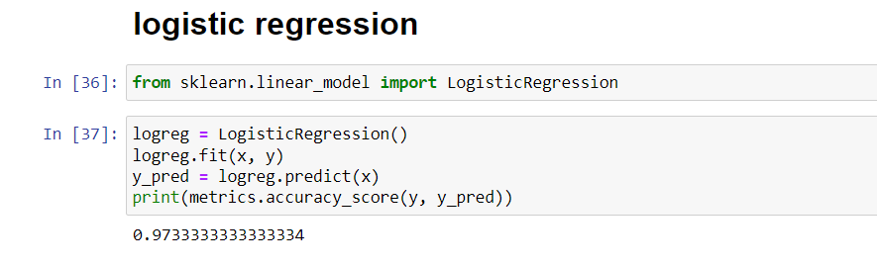
Implementation
LOGISTIC REGRESSION
Logistic regression is a statistical model that in its basic form uses a logistic function to model a binary dependent variable, although many more complex extensions exist

Slide 16
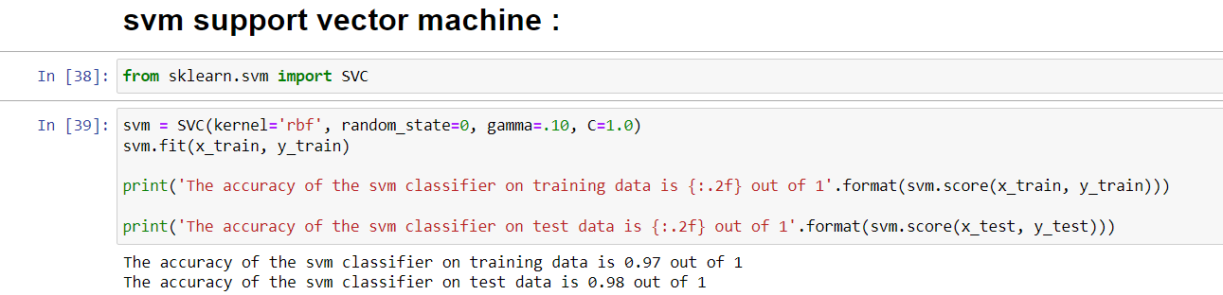
Implementation
SVM
Support vector machines (SVMs) are a set of supervised learning methods used for classification, regression and outliers detection. The advantages of support vector machines are: Effective in high dimensional spaces. Still effective in cases where number of dimensions is greater than the number of samples

Slide 17
RESULTS
Knn accuracy is 0.97.
Logistic regression is 0.973333333334.
Svm accuracy is 0.98.

Slide 18
Conclusion
The proposed model is the best substitute for the manual method where a third party is involved as the middleman and is potentially vulnerable along with it being cheaper for the end customers.
Based on the results, it can be concluded that such ML-driven predictions are easily comprehendible and significant from a data-analytics point of view.
When correctly implemented, a high rate of accuracy can be achieved.

Slide 19
Future Enhancements
To make the interface more informative and user-friendly by implementing better GUI designs.
Using bigger training data sets to get a more accurate estimate of the prices.
Implementing other machine learning algorithms which can improve the accuracy of the model.

Slide 20
REFERENCES
1) Dual Spatial Attention Network for Iris Recognition
DOI: 10.1109/WACV48630.2021.00093
2)A novel fuzzy clustering method based on GA, PSO and Subtractive Clustering
Year: 2020, Pages: 331-337
DOI Bookmark: 10.1109/CSCI51800.2020.00063
3) A novel fuzzy clustering method based on GA, PSO and Subtractive Clustering
Year: 2020, Pages: 331-337
DOI Bookmark: 10.1109/CSCI51800.2020.00063

Slide 21
THANK YOU

